Slide 1



Capstone Project
“Optimizing Operational Efficiency and Inventory Management for Tim Hortons”
Group Members:
Hashwanth Adapa
Jaspreet Singh Saini
Kaival Patel
Nilesh Kokulwar
Priyankaben Kaloliya
Sree Keerthi Kandula

Slide 2
Understanding the Business Problem
High and Unexplained Waste: Specific inventory items showed consistently high waste, with limited visibility into underlying causes.
Unclear Sales Trends: Inconsistent sales patterns made it difficult to plan staffing and inventory effectively. Sales fluctuate unpredictably across weekdays vs. weekends.
Labor Efficiency Gaps: Mismatches between labor hours and sales raised concerns, with metrics like SPLH and CPLH showing significant fluctuations.

Slide 3
Our Data-Driven Approach
Phase 1: Exploratory Data Analysis (EDA) & Dashboards
Phase 2: Machine Learning Models, Hypothesis Testing & Sentiment Analysis
Analysis based on 2022 data from Tim Hortons LaSalle store + Google Reviews
Collaborated with store manager to align analysis with operational needs.
Deliverables: Dashboards, Predictive Models, Hypothesis Validation

Slide 4
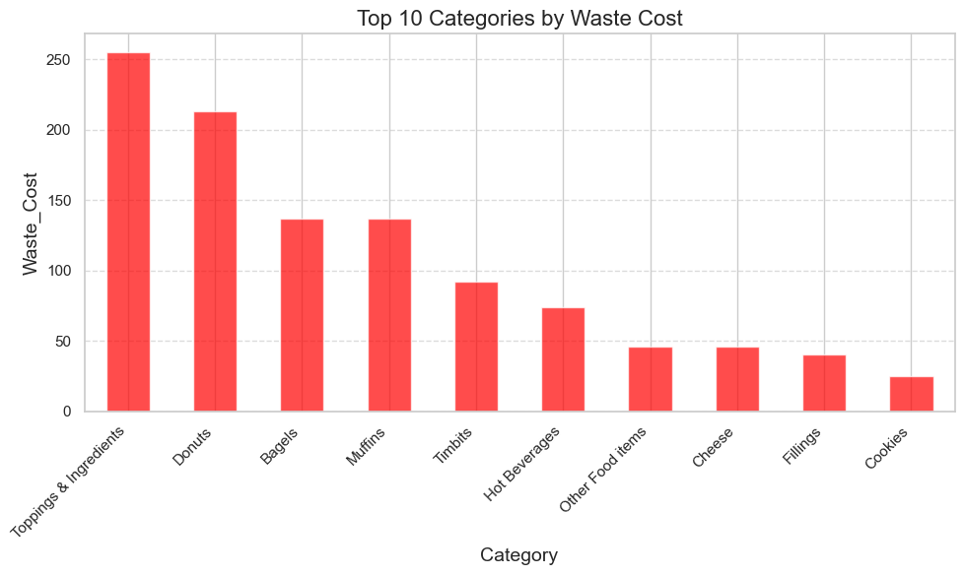
Exploratory Data Analysis – Laying the Groundwork
Discovered seasonal waste patterns (e.g., spikes in summer)
Labor costs did not align with SPLH
Key waste drivers identified: Toppings, Bakery Items showed the highest waste.
Summer waste spiked by 20%
due to perishable items like dairy.

Slide 5
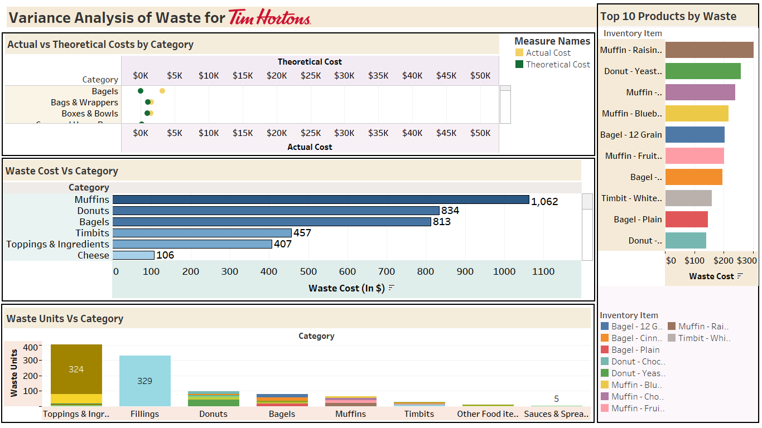
Interactive Dashboards – Making Data Visible
Built dynamic Tableau dashboards
Visualized waste by category, SPLH trends etc.
Dashboard

Slide 6
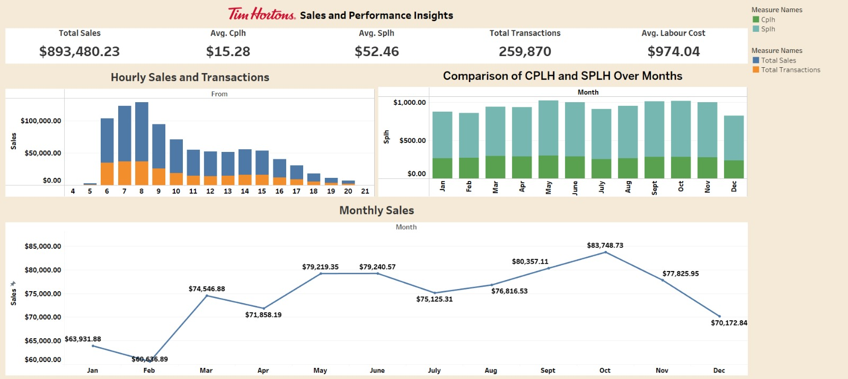
Dashboard

Slide 7
Moving Beyond Descriptive Analytics
Identified a need to predict and prevent issues, not just observe them
Introduced machine learning and hypothesis testing to dig deeper.
“Machine Learning Implementation”

Slide 8
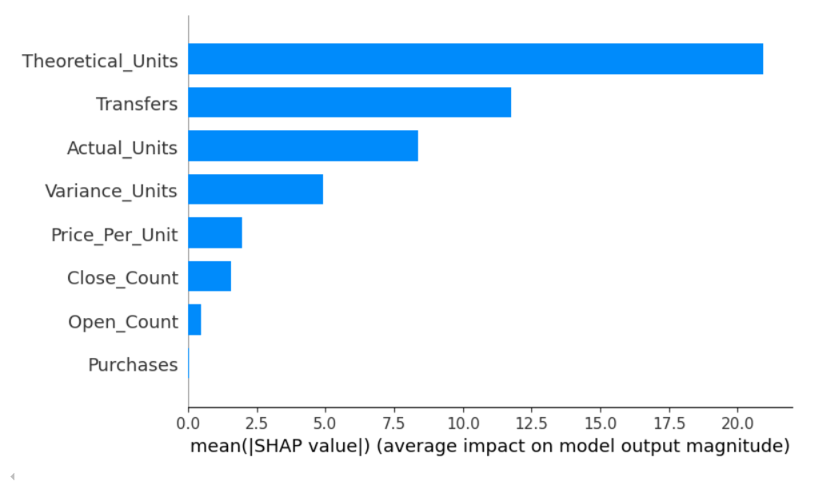
Feature Importance – Uncovering Key Drivers
Analyzed what impacts Net Sales and Waste Cost
Used Random Forest & SHAP to rank variables
Top drivers: Variance Units, Price Per Unit, Inventory Category (e.g., Bakery Items)
Ranked feature bar chart

Slide 9
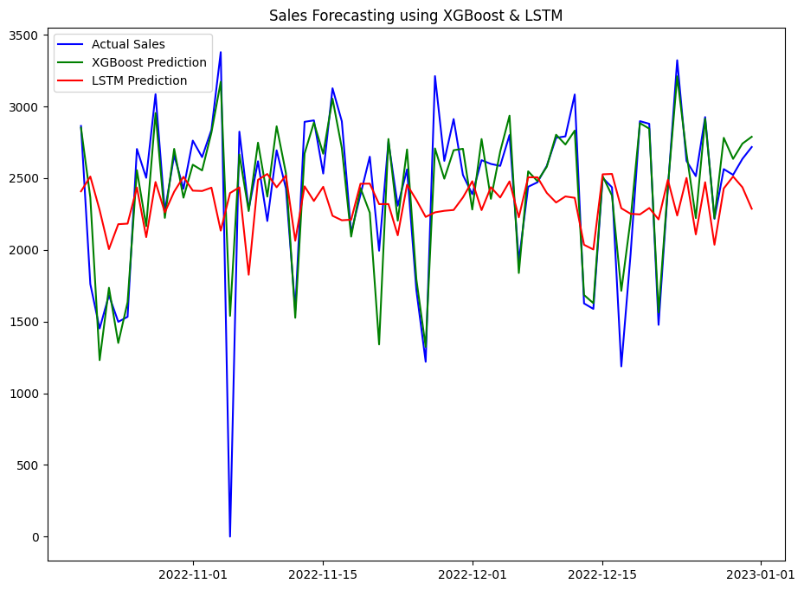
Forecasting Net Sales with ML (XGBoost)
Regression model to predict Net sales
Features: 'Year', 'Month', 'Day', 'Day_of_Week', 'Is_Weekend', 'Quarter’ etc.
Metric: R² = 0.792

Slide 10
Predicting Waste Cost for Inventory Control
Modeled Waste Cost using Random Forest Regressor on Waste Variance Dataset
Features: ‘Price_Per_Unit', 'Open_Count', 'Purchases', 'Transfers', 'Close_Count’, 'Actual_Units', 'Theoretical_Units', 'Variance_Units’
Enhanced with features like “Waste_to_Actual_Ratio” and “Unit_Cost_Impact”.
Metric:
R² = 0.8846 | RMSE: 6.80

Slide 11
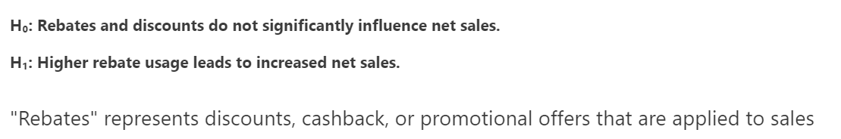
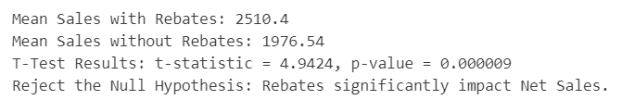
Validating Insights with Hypothesis Testing
1. Relationship Between Net Sales and Rebate Usage

Slide 12


Validating Insights with Hypothesis Testing
2. Relationship between Hours and Sales

Slide 13
Validating Insights with Hypothesis Testing
3. Items with smaller pack sizes have lower waste costs
compared to items with larger pack sizes.

Slide 14
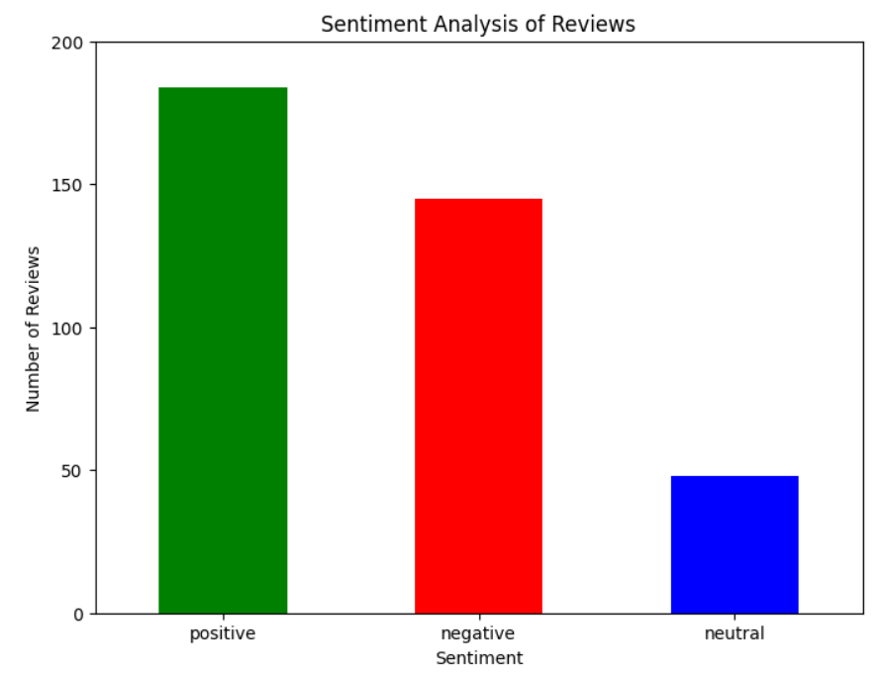
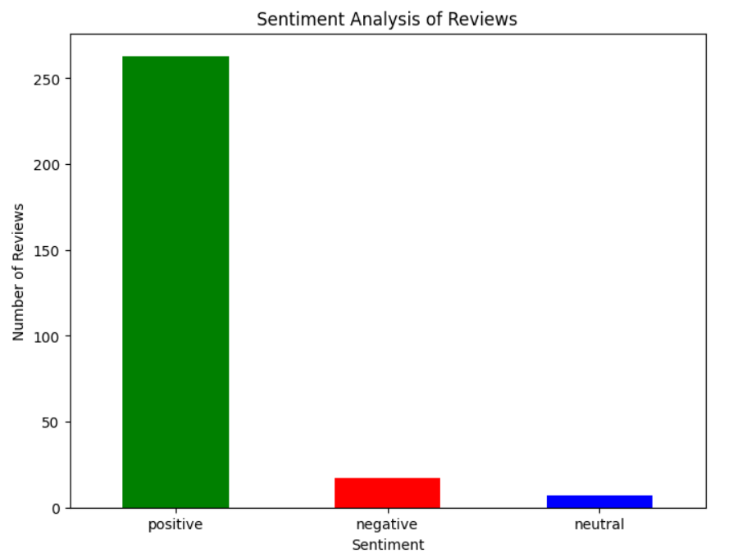
Sentiment Analysis – Understanding the Customer’s Voice
Analyzed Google Reviews for Tim Hortons (LaSalle vs Windsor)
Key terms: “friendly staff”, “long wait”, “great service”
LaSalle: 60% positive, 30% negative (long wait times); Windsor: 80% positive (great service)

Slide 15










Business Impact and Key Outcomes
Operational Dashboards
Waste Reduction
Empowered real-time visibility and decision-making through interactive visual tools.
Identified key waste drivers and forecasted waste cost to support better inventory control.
Improved Forecasting
End-to-End Analytics
Net sales prediction enabled smarter labor scheduling and resource allocation.
Combined EDA, Machine Learning, Hypothesis Testing, and Sentiment Analysis for comprehensive insight.

Slide 16
Lessons Learned & Recommendations
Lessons Learned:
Real-world data is messy but full of value.
Combining descriptive and predictive analytics unleashes deeper insights.
Cross-functional collaboration enhances solution relevance.
Recommendations:
Extend predictive models to Windsor and Toronto stores for comparative analysis.
Automate data refresh for live dashboard updates.
Explore reinforcement learning for real-time inventory management.

Slide 17
Conclusion – From Insight to Impact
Identified key inefficiencies using EDA and dashboards.
Applied machine learning to forecast sales and waste patterns.
Validated findings through statistical and sentiment analysis.
Delivered an end-to-end analytical strategy tailored for retail operations.

Slide 18



Thank You!
See You at Tim’s?

